Slide 1
Software engineering project
Tom leonard
Lucas villiere

Slide 2

Goal of the project
Develop game / quiz / other tool to promote the faculty FSTM

Slide 3

Get to know the FSTM through music
An app or a website that allows the user to get to know the FSTM through their taste in music, such as what songs they listen to concentrate, relax, when their sad or happy etc

Slide 4
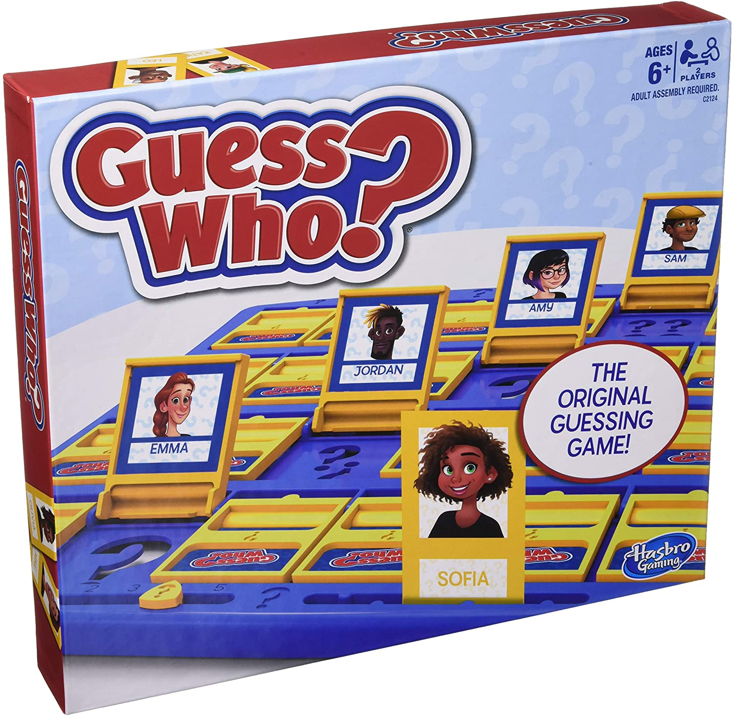
Guess who ? It’s the FSTM !
A guess who style game where the FSTM are the options

Slide 5
An assortment of minigames
A bunch of different minigames that with a twist involving the FSTM
A hanged man with their names
A bunch of trivia quizzes
a flappy bird style game with staff faces
Etc…

Slide 6
Thank you for listening!
Any feedback or questions are always welcome

